Slide 1

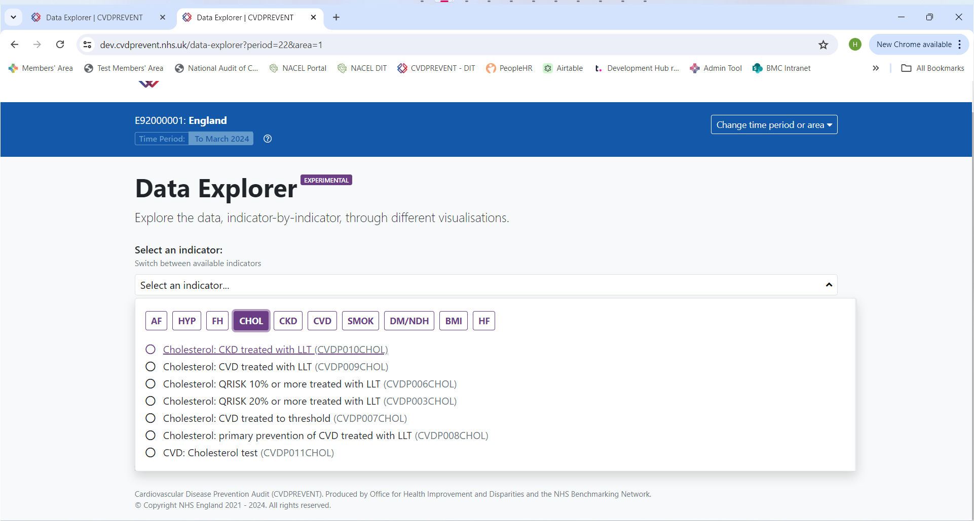
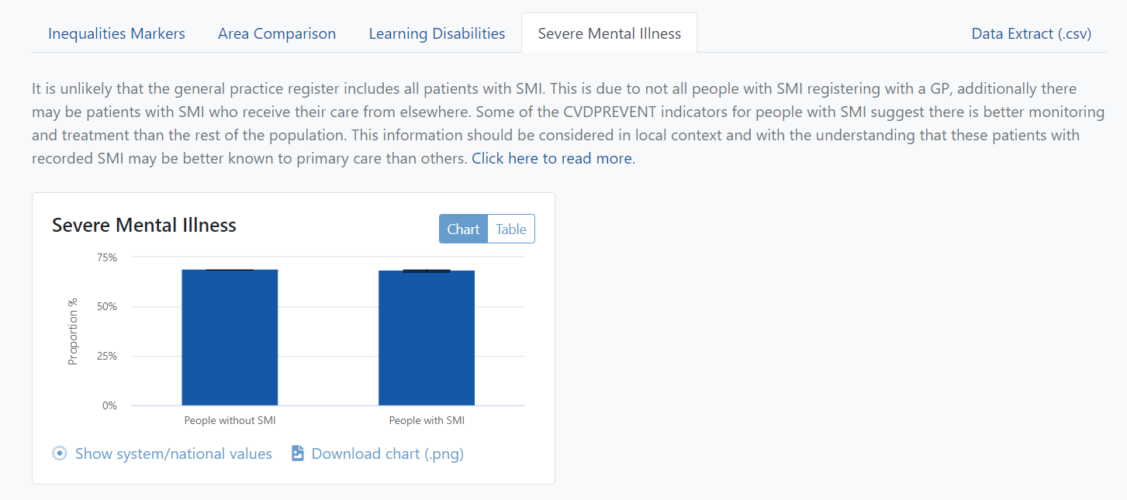
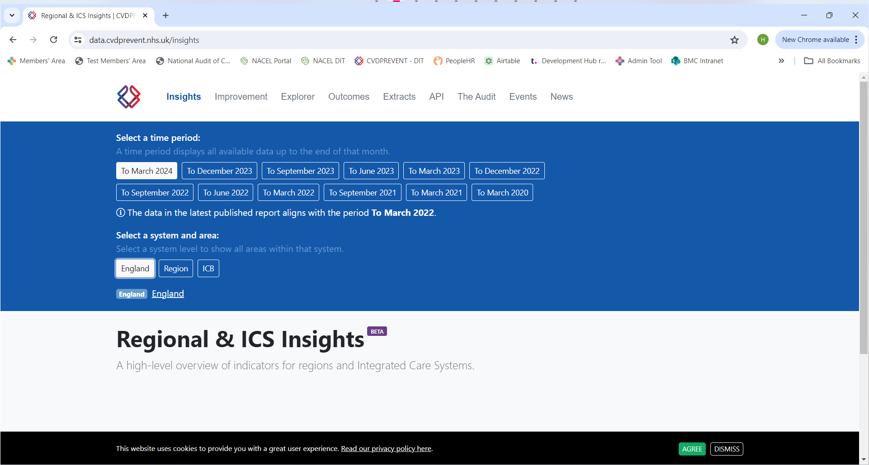
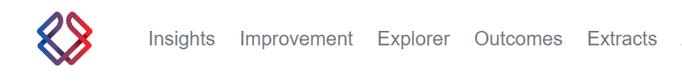
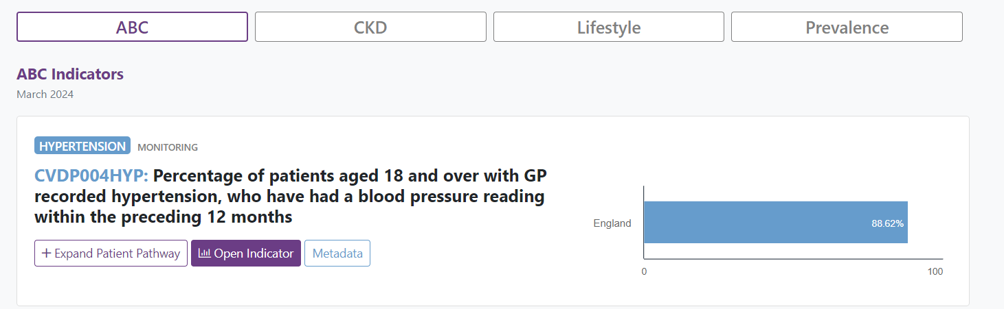
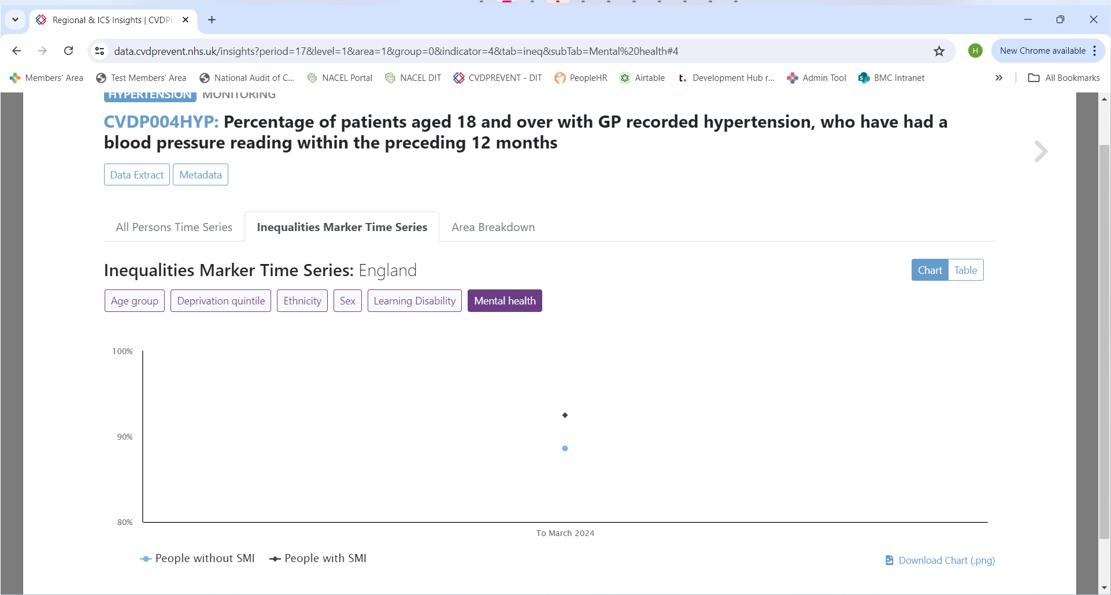
Severe mental illness (SMI) data breakdown user guidance
The data presented in the CVDPREVENT tool can be used to evaluate the status and progress of the care pathway for patients with SMI, supporting objectives to improve their physical health and reduce premature mortality from cardiovascular disease (CVD). This guide shows you where to find this data on the online CVDPREVENT Data & Improvement Tool.
Choose an indicator from the list
Click on the ‘Explorer’ view
Select the ‘Severe Mental Illness’ tab
Select a time period and choose an area
Visit the Data & Improvement Tool online at:​ www.cvdprevent.nhs.uk
Click on the ‘Inequalities Marker Time Series’ tab and select ‘Mental Health’
Click on the ‘Insights’ view
Choose an indicator and select ‘Open Indicator’
Please note, not all indicators have SMI data. Please see page 2 of this document for a list of indicators with and without SMI data. The data is also only available at national, regional and ICB levels and is not available for individual PCNs or practices.

Slide 2
Severe Mental Illness (SMI) Indicator List
While most indicators include a breakdown of SMI data, some do not. This document identifies which indicator IDs contain SMI data and which do not.
Indicators with SMI data
CVDP002AF
CVDP004AF
CVDP005AF
CVDP002HYP
CVDP003HYP
CVDP004HYP
CVDP006HYP
CVDP007HYP
CVDP009HYP
CVDP004CKD
CVDP005CKD
CVDP006CKD
CVDP007CKD
CVDP003CHOL
CVDP006CHOL
CVDP008CHOL
CVDP009CHOL
CVDP010CHOL
CVDP011CHOL
CVDP012CHOL
CVDP001SMOK
CVDP002SMOK
CVDP001BMI
CVDP002STRK
CVDP002CHD
CVDP002HF
Indicators without SMI data
CVDP001AF
CVDP001HYP
CVDP005HYP
CVDP001CKD
CVDP002CKD
CVDP003CKD
CVDP005DM
CVDP003DM
CVDP002FH
CVDP003FH
CVDP004FH
CVDP001CVD
CVDP002NDH
CVDP001HF

